Slide 1

Titanic Survival Prediction

Slide 2
Problem Statement
The sinking of the RMS Titanic is one of the most infamous shipwrecks in history.
In this challenge, we were ask to complete the analysis of what sorts of people were likely to survive.
In this we apply machine learning tools to predict which passenger survived in the tragedy.
In this project we apply many algorithm to check the accuracy of the data.

Slide 3
Exploratory Data Analysis
Import Titanic train dataset.
Checking the number and data types of features or columns.
By visualization technique we can see the survival data of Gender and Pclass, i.e. More than 500 peoples did not survived and approx 300 peoples survived in the tragedy.
Checking the null values in the data. So there are null values in Age, Cabin and Embarked.
By doing EDA on the data just remove all the null values.
Now apply algorithms to calculate the accuracy of the model by logistic regression, Knn classifier, Decision Tree and Random forest classifier.
And calculate which model works better for this data.

Slide 4
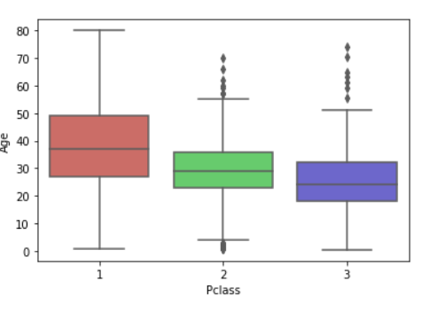
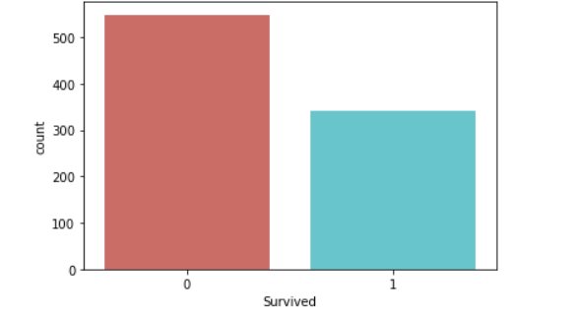
Survival Visualization by Age and Pclass
As we can see in the bar graph,
0=Not survived peoples which are Approx 500
1= Survived peoples which are Approx 300
By this box plot we can see that,
In Pclass 1 there were passengers between age 30 to 50.
In Pclass 2 there were passengers between age 25 to 35
In Pclass 3 there were passengers between age 20 to 30

Slide 5
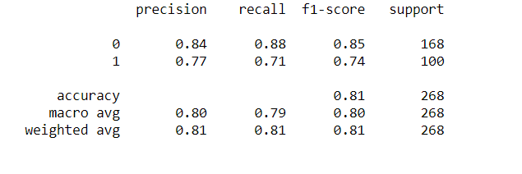
Algorithms- Logistic Regression
Logistic regression is the appropriate regression analysis to conduct when the dependent variable is dichotomous (binary). Like all regression analyses, the logistic regression is a predictive analysis. Logistic regression is used to describe data and to explain the relationship between one dependent binary variable and one or more nominal, ordinal, interval or ratio-level independent variables.
By this and by confusion matrix we are getting accuracy as 81%

Slide 6
Decision Tree
Decision Tree algorithm belongs to the family of supervised learning algorithms. The goal of using a Decision Tree is to create a training model that can use to predict the class or value of the target variable by learning simple decision rules inferred from prior data(training data)
We are getting accuracy as 97.91%

Slide 7
Random Forest Classifier
Random forests or random decision forests are an ensemble learning method for classification, regression and other tasks that operate by constructing a multitude of decision trees at training time and outputting the class that is the mode of the classes or mean prediction of the individual trees.
We get 97% accuracy by this algorithm

Slide 8
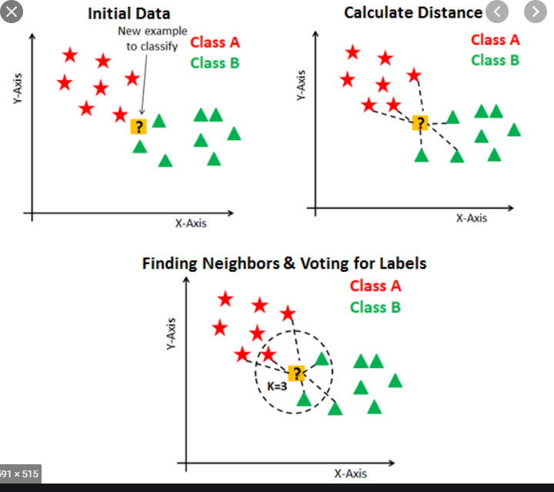
KNN Classifier
In pattern recognition, the k-nearest neighbors algorithm is a non-parametric method proposed by Thomas Cover used for classification and regression. In both cases, the input consists of the k closest training examples in the feature space.
In this algorithm we get 70% accuracy

Slide 9
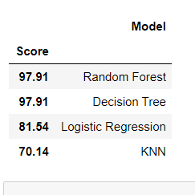
The best model for this dataset.
Random forest and Decision Tree are getting almost same accuracy in this dataset i.e.97.91%

Slide 10


